Slide 1
Computer Security:
Principles and Practice
Fourth Edition, Global Edition
By: William Stallings and Lawrie Brown
Notes:
Lecture slides prepared for “Computer Security: Principles and Practice”, 4/e, GE, by William Stallings and Lawrie Brown, Chapter 22 “Internet Security Protocols and Standards”.

Slide 2
Chapter 22
Internet Security Protocols and Standards
Notes:
This chapter looks at some of the most widely used and important Internet security
protocols and standards.

Slide 3
Securing E-Maile
Secure E-Mail
S/MIME
PGP

Slide 4
MIME and S/MIME
MIME
S/MIME
Extension to the old RFC 822 specification of an Internet mail format
RFC 822 defines a simple heading with To, From, Subject
Assumes ASCII text format
Provides a number of new header fields that define information about the body of the message
Secure/Multipurpose Internet Mail Extension
Security enhancement to the MIME Internet e-mail format
Based on technology from RSA Data Security
Provides the ability to sign and/or encrypt e-mail messages
Notes:
S/MIME (Secure/Multipurpose Internet Mail Extension) is a security enhancement
to the MIME Internet e-mail format standard.
MIME is an extension to the old RFC 822 (Standard For The Format of ARPA Internet Text Messages, 1982:
specification of an Internet mail format. RFC 822 defines a simple header with To, From, Subject, and other fields that can
be used to route an e-mail message through the Internet and that provides basic
information about the e-mail content. RFC 822 assumes a simple ASCII text format
for the content.
MIME provides a number of new header fields that define information about
the body of the message, including the format of the body and any encoding that
is done to facilitate transfer. Most important, MIME defines a number of content
formats, which standardize representations for the support of multimedia e-mail.
Examples include text, image, audio, and video.

Slide 5
S/MIME Functions
Enveloped data
Encrypted content and associated keys
Signed data
Encoded message + signed digest
Clear-signed data
Cleartext message + encoded signed digest
Signed and enveloped data
Nesting of signed and encrypted entities
Notes:
In essence, these content types support four new functions:
• Enveloped data: This function consists of encrypted content of any type and
encrypted-content encryption keys for one or more recipients.
• Signed data: A digital signature is formed by taking the message digest of the
content to be signed and then encrypting that with the private key of the signer.
The content plus signature are then encoded using base64 encoding. A signed
data message can only be viewed by a recipient with S/MIME capability.
• Clear-signed data: As with signed data, a digital signature of the content is
formed. However, in this case, only the digital signature is encoded using
base64. As a result, recipients without S/MIME capability can view the
message content, although they cannot verify the signature.
• Signed and enveloped data: Signed-only and encrypted-only entities may be
nested, so that encrypted data may be signed and signed data or clear-signed
data may be encrypted.

Slide 6
Notes:
Figure 22.1 provides a general overview of S/MIME functional flow.

Slide 7
Signed and Clear-Signed Data
The preferred algorithms used for signing S/MIME messages use either an RSA or a DSA signature of a SHA-256 message hash
The process works as follows:
Take the message you want to send and map it into a fixed-length code of 256 bits using SHA-256
The 256-bit message digest is unique for this message making it virtually impossible for someone to alter this message or substitute another message and still come up with the same digest
S/MIME encrypts the digest using RSA and the sender’s private RSA key
The result is the digital signature, which is attached to the message
Now, anyone who gets the message can recompute the message digest then decrypt the signature using RSA and the sender’s public RSA key
Since this operation only involves encrypting and decrypting a 256-bit block, it takes up little time
Notes:
The preferred algorithms used for signing
S/MIME messages use either an RSA or a Digital Signature Algorithm (DSA) signature
of an SHA-256 message hash. The process works as follows. Take the message
you want to send and map it into a fixed-length code of 256 bits, using SHA-256.
The 256-bit message digest is, for all practical purposes, unique for this message.
It would be virtually impossible for someone to alter this message or substitute
another message and still come up with the same digest. Then, S/MIME encrypts the
digest using RSA and the sender’s private RSA key. The result is the digital signature,
which is attached to the message, as we discuss in Chapter 2. Now, anyone who gets
this message can recompute the message digest then decrypt the signature using RSA
and the sender’s public RSA key. If the message digest in the signature matches the
message digest that was calculated, then the signature is valid. Since this operation
only involves encrypting and decrypting a 256-bit block, it takes up little time. The
DSA can be used instead of RSA as the signature algorithm.
The signature is a binary string, and sending it in that form through the Internet
e-mail system could result in unintended alteration of the contents, because some
e-mail software will attempt to interpret the message content looking for control
characters such as line feeds. To protect the data, either the signature alone or the signature
plus the message are mapped into printable ASCII characters using a scheme
known as radix-64 or base64 mapping. Radix-64 maps each input group of three octets
of binary data into four ASCII characters (see Appendix G).

Slide 8
Enveloped Data
Default algorithms used for encrypting S/MIME messages are AES and RSA
S/MIME generates a pseudorandom secret key that is used to encrypt the message using AES or some other conventional encryption scheme
A new pseudorandom key is generated for each new message encryption
This session key is bound to the message and transmitted with it
The secret key is used as input to the public-key encryption algorithm, RSA, which encrypts the key with the recipient’s public RSA key
On the receiving end, S/MIME uses the receiver's private RSA key to recover the secret key, then uses the secret key and AES to recover the plaintext message
If encryption is used alone, radix-64 is used to convert the ciphertext to ASCII format
Notes:
The default algorithms used for encrypting S/MIME messages are
AES and RSA. To begin, S/MIME generates a pseudorandom secret key; this is used to
encrypt the message using AES or some other conventional encryption scheme, such as
3DES. In any conventional encryption application, the problem of key distribution must
be addressed. In S/MIME, each conventional key is used only once. That is, a new pseudorandom
key is generated for each new message encryption. This session key is bound
to the message and transmitted with it. The secret key is used as input to the public-key
encryption algorithm, RSA, which encrypts the key with the recipient’s public RSA key.
On the receiving end, S/MIME uses the receiver’s private RSA key to recover the secret
key, then uses the secret key and AES to recover the plaintext message.
If encryption is used alone, radix-64 is used to convert the ciphertext to ASCII
format.

Slide 9
Requirement Achieved by S/MIME
What are the security requirements Achieved by S/MIME?

Slide 10


PGP: Pretty Good Privacy
Secure Email
Alice wants to send confidential e-mail, m, to Bob.
K_{S}
.
K_{S}(m )
K_{S}(m )
.
m
K_{S}( )
K_{S}( )
m
+
-
K_{S}
Internet
.
.
+
-
K_{S}
K_{B}( )
+
+
K_{B}( )
K_{B}(K_{S} )
K_{B}(K_{S} )
+
-
K_{B}
K_{B}
Alice:
generates random symmetric private key, K_{S}.
encrypts message with K_{S} (for efficiency)
also encrypts K_{S} with Bob’s public key.
sends both K_{S}(m) and K_{B}(K_{S}) to Bob.

Slide 11
Secure Email
Alice wants to send confidential e-mail, m, to Bob.
K_{S}
.
K_{S}(m )
K_{S}(m )
.
m
K_{S}( )
K_{S}( )
m
+
-
K_{S}
Internet
.
.
+
-
K_{S}
K_{B}( )
+
+
K_{B}( )
K_{B}(K_{S} )
K_{B}(K_{S} )
+
-
K_{B}
K_{B}
Bob:
uses his private key to decrypt and recover K_{S}
uses K_{S} to decrypt K_{S}(m) to recover m

Slide 12
PGP: Secure e-mail (continued)
Alice wants to provide sender authentication message integrity.
-
+
K_{A}
K_{A}
.
.
-
-
.
-
K_{A}(H(m))
K_{A}(H(m))
+
H(m )
m
H( )
K_{A}( )
K_{A}( )
+
-
compare
Internet
.
m
H( )
H(m )
m
Alice digitally signs message.
sends both message (in the clear) and digital signature.

Slide 13
PGP: Secure e-mail (continued)
Alice wants to provide secrecy, sender authentication, message integrity.
-
K_{A}
.
.
-
-
K_{A}(H(m))
K_{S}
m
H( )
K_{A}( )
.
+
K_{S}( )
m
+
Internet
.
+
K_{S}
K_{B}( )
+
K_{B}(K_{S} )
+
K_{B}
Alice uses three keys: her private key, Bob’s public key, newly created symmetric key

Slide 14
Pretty good privacy (PGP)
Internet e-mail encryption scheme, de-facto standard.
uses symmetric key cryptography, public key cryptography, hash function, and digital signature as described.
provides secrecy, sender authentication, integrity.
inventor, Phil Zimmerman, was target of 3-year federal investigation.
A PGP signed message:
---BEGIN PGP SIGNED MESSAGE---
Hash: SHA1
Bob:My husband is out of town tonight.Passionately yours, Alice
---BEGIN PGP SIGNATURE---
Version: PGP 5.0
Charset: noconv
yhHJRHhGJGhgg/12EpJ+lo8gE4vB3mqJhFEvZP9t6n7G6m5Gw2
---END PGP SIGNATURE---

Slide 15
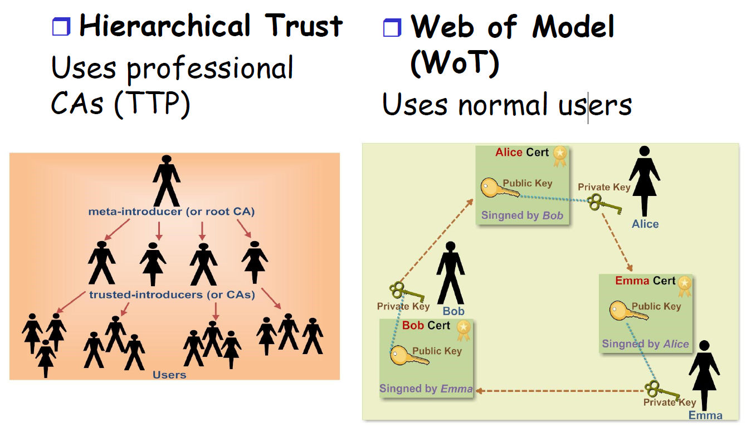
Trust Models

Slide 16
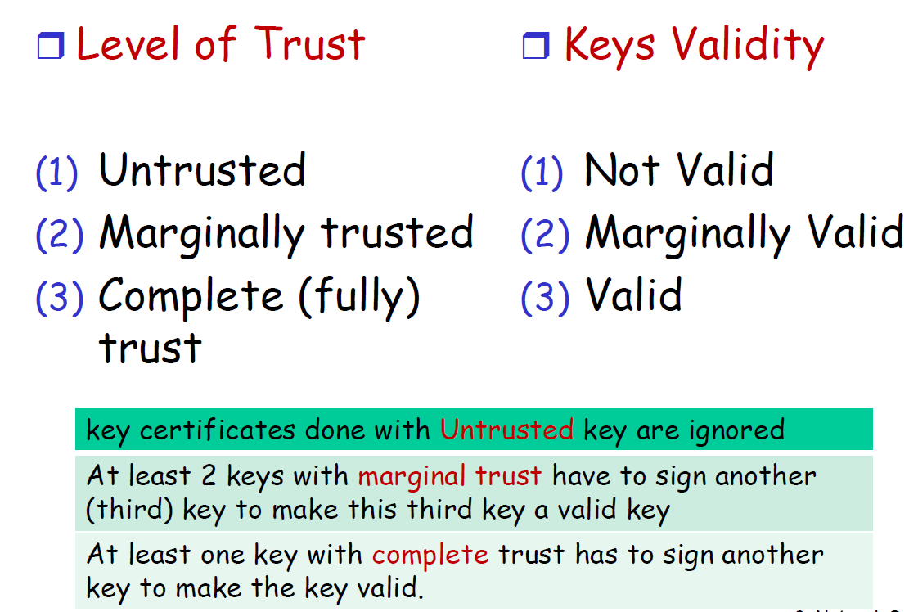
Web of Trust

